Slide 1
The Social Psychology of Networks
(The micro underneath the macro)

Slide 2
Triadic Balance Theory

Slide 3
Balance theory
Balance theory is a social psychological theory designed to explain expected triadic configurations in sentiment networks
  Sentiment networks are built from valenced ties (e.g., positive or negative)

Slide 4
Balance theory
Balance theory is a social psychological theory designed to explain expected triadic configurations in sentiment networks
  Sentiment networks are built from valenced ties (e.g., positive or negative)
There are four building blocks in balance theory
  (1) A person (P)
    We “look” at the triad from this person’s point of view
P

Slide 5
Balance theory
Balance theory is a social psychological theory designed to explain expected triadic configurations in sentiment networks
  Sentiment networks are built from valenced ties (e.g., positive or negative)
There are four building blocks in balance theory
  (2) An object (O) towards which the focal person has some kind of sentiment
    The sentiment can be positive or negative
P
O

Slide 6
Balance theory
Balance theory is a social psychological theory designed to explain expected triadic configurations in sentiment networks
  Sentiment networks are built from valenced ties (e.g., positive or negative)
There are four building blocks in balance theory
  (3) A third party (Q) towards which both the person and the other also have some kind of sentiment
Q
P
O

Slide 7
Balance theory
Balance theory is a social psychological theory designed to explain expected triadic configurations in sentiment networks
  Sentiment networks are built from valenced ties (e.g., positive or negative)
There are four building blocks in balance theory
  (4) A set of directed signed edges that indicate positive (solid) or negative (dashed) sentiments that P and O have toward the third party Q and P towards O
Q
P
O

Slide 8
Balance theory
Balance theory is a social psychological theory designed to explain expected triadic configurations in sentiment networks
  Sentiment networks are built from valenced ties (e.g., positive or negative)
There are four building blocks in balance theory
  (4) A set of directed signed edges that indicate positive (solid) or negative (dashed) sentiments that P and O have toward the third party Q and P towards O
Q
This reads:
Person (P) likes other (O)
Other (O) likes the third party (Q)
But person (P) dislikes the third party
P
O

Slide 9
Balance theory
Balance theory is a social psychological theory designed to explain expected triadic configurations in sentiment networks
  Sentiment networks are built from valenced ties (e.g., positive or negative)
There are four building blocks in balance theory
  (4) A set of directed signed edges that indicate positive (solid) or negative (dashed) sentiments that P and O have toward the third party Q and P towards O
Q
Example: You (P) have a friend (O) whom you like and they like another classmate (Q) who you dislike
Sounds dicey!
P
O

Slide 10
Balance theory
Balance theory is a social psychological theory designed to explain expected triadic configurations in sentiment networks
  Sentiment networks are built from valenced ties (e.g., positive or negative)
There are four building blocks in balance theory
  (4) A set of directed signed edges that indicate positive (solid) or negative (dashed) sentiments that P and O have toward the third party Q and P towards O
Q
In this example, you (P) have a friend (O) who you like and they like another classmate (Q) whom you also like.
Everything’s fine!
P
O

Slide 11
Balance theory
Balance theory is a social psychological theory designed to explain expected triadic configurations in sentiment networks
  Sentiment networks are built from valenced ties (e.g., positive or negative)
There are four building blocks in balance theory
  (4) A set of directed signed edges that indicate positive (solid) or negative (dashed) sentiments that P and O have toward the third party Q and P towards O
Q
In this example, you (P) have an enemy (O) who likes another classmate (Q) who you dislike
Seems fine?
P
O

Slide 12
Balance theory
Balance theory is a social psychological theory designed to explain expected triadic configurations in sentiment networks
  Sentiment networks are built from valenced ties (e.g., positive or negative)
There are four building blocks in balance theory
  Q does not have to be a real person!
    It could be any object
Q
In this example, you (P) love Marvel movies (Q) but your long time partner O (who you like duh!) hates them
Trouble in paradise!
P
O

Slide 13
Balance theory
There are eight (8) configurations featuring one-way directed links from:
  Person (P) to Other (O)
  Person (P) to Third Party (Q)
  Other (O) to Third Party (Q)

Slide 14
Balance theory
There are eight (8) configurations featuring one-way directed links from:
  Person (P) to Other (O)
  Person (P) to Third Party (Q)
  Other (O) to Third Party (Q)
Everything’s fine here!
Q
Q
P
P
O
O
Q
Q
P
P
O
O
Balanced Configurations

Slide 15
Balance theory
There are eight (8) configurations featuring one-way directed links from:
  Person (P) to Other (O)
  Person (P) to Third Party (Q)
  Other (O) to Third Party (Q)
Trouble in paradise!
Q
Q
Q
Q
P
P
P
P
O
O
O
O
Q
Q
Q
Q
P
P
P
P
O
O
O
O
Unbalanced Configurations
Balanced Configurations

Slide 16
Balance theory
Basic idea is that unbalanced configurations will tend to transition to balanced configurations
  Unbalanced configurations produce tension in P leading them to change their sentiments toward O or Q to generate balance
Q
Q
Q
Q
P
P
P
P
O
O
O
O
Q
Q
Q
Q
P
P
P
P
O
O
O
O
Unbalanced Configurations
Balanced Configurations

Slide 17
Balance theory
Basic idea is that unbalanced configurations will tend to transition to balanced configurations
  Unbalanced configurations produce tension in P leading them to change their sentiments toward O or Q to generate balance
Q
Q
Q
Q
P
P
P
P
O
O
O
O
Q
Q
Q
Q
P
P
P
P
O
O
O
O
Unbalanced Configurations
Balanced Configurations

Slide 18
Balance theory
Basic idea is that unbalanced configurations will tend to transition to balanced configurations
  Unbalanced configurations produce tension in P leading them to change their sentiments toward O or Q to generate balance
Q
Q
Q
Q
P
P
P
P
O
O
O
O
Q
Q
Q
Q
P
P
P
P
O
O
O
O
Unbalanced Configurations
Balanced Configurations

Slide 19
Balance theory
Basic idea is that unbalanced configurations will tend to transition to balanced configurations
  Unbalanced configurations produce tension in P leading them to change their sentiments toward O or Q to generate balance
Q
Q
Q
Q
P
P
P
P
O
O
O
O
Q
Q
Q
Q
P
P
P
P
O
O
O
O
Unbalanced Configurations
Balanced Configurations

Slide 20
Balance theory
Basic idea is that unbalanced configurations will tend to transition to balanced configurations
  Unbalanced configurations produce tension in P leading them to change their sentiments toward O or Q to generate balance
Q
Q
Q
Q
P
P
P
P
O
O
O
O
Q
Q
Q
Q
P
P
P
P
O
O
O
O
Unbalanced Configurations
Balanced Configurations

Slide 21
The Mathematics of Balance Theory
Remember the rules of sign multiplication from basic algebra?
  +1 * +1 = +1
  +1 * -1 = -1
  -1 * -1 = +1
Q
Q
Q
Q
P
P
P
P
O
O
O
O
Q
Q
Q
Q
P
P
P
P
O
O
O
O
Unbalanced Configurations
Balanced Configurations

Slide 22
The Mathematics of Balance Theory
Remember the rules of sign multiplication from basic algebra?
  +1 * +1 = +1
  +1 * -1 = -1
  -1 * -1 = +1
They apply to balance theory!
Q
Q
Q
Q
P
P
P
P
O
O
O
O
Q
Q
Q
Q
P
P
P
P
O
O
O
O
Unbalanced Configurations
Balanced Configurations

Slide 23
The Mathematics of Balance Theory
Turns out that if you multiply the signs of the edges of each of the unbalanced triads you get a negative number
  Try it!
Q
Q
Q
Q
P
P
P
P
O
O
O
O
Q
Q
Q
Q
P
P
P
P
O
O
O
O
Unbalanced Configurations
Balanced Configurations

Slide 24
The Mathematics of Balance Theory
Turns out that if you multiply the signs of the edges of each of the unbalanced triads you get a negative number
  +1_{PO} * +1_{OQ} * -1_{PQ} = -1_{POQ}
Q
Q
Q
Q
P
P
P
P
O
O
O
O
Q
Q
Q
Q
P
P
P
P
O
O
O
O
Unbalanced Configurations
Balanced Configurations

Slide 25
The Mathematics of Balance Theory
Turns out that if you multiply the signs of the edges of each of the unbalanced triads you get a negative number
  +1_{PO} * -1_{OQ} * +1_{PQ} = -1_{POQ}
Q
Q
Q
Q
P
P
P
P
O
O
O
O
Q
Q
Q
Q
P
P
P
P
O
O
O
O
Unbalanced Configurations
Balanced Configurations

Slide 26
The Mathematics of Balance Theory
Conversely, if you multiply the sign of the edges of the balanced triads you get a positive number:
  -1_{PO} * +1_{OQ} * -1_{PQ} = +1_{POQ}
Q
Q
Q
Q
P
P
P
P
O
O
O
O
Q
Q
Q
Q
P
P
P
P
O
O
O
O
Unbalanced Configurations
Balanced Configurations

Slide 27
The Mathematics of Balance Theory
Conversely, if you multiply the sign of the edges of the balanced triads you get a positive number:
  +1_{PO} * -1_{OQ} * -1_{PQ} = +1_{POQ}
Q
Q
Q
Q
P
P
P
P
O
O
O
O
Q
Q
Q
Q
P
P
P
P
O
O
O
O
Unbalanced Configurations
Balanced Configurations

Slide 28
The Mathematics of Balance Theory
A link between mathematics and the logic of social relations!
  “A friend of a friend is a friend”
  +1_{PO} * +1_{OQ} * +1_{PQ} = +1_{POQ}
Q
Q
Q
Q
P
P
P
P
O
O
O
O
Q
Q
Q
Q
P
P
P
P
O
O
O
O
Unbalanced Configurations
Balanced Configurations

Slide 29
The Mathematics of Balance Theory
A link between mathematics and the logic of social relations!
  “A friend of an enemy is an enemy”
  -1_{PO} * +1_{OQ} * -1_{PQ} = +1_{POQ}
Q
Q
Q
Q
P
P
P
P
O
O
O
O
Q
Q
Q
Q
P
P
P
P
O
O
O
O
Unbalanced Configurations
Balanced Configurations

Slide 30
The Mathematics of Balance Theory
A link between mathematics and the logic of social relations!
  “An enemy of a friend is an enemy”
  +1_{PO} * -1_{OQ} * -1_{PQ} = +1_{POQ}
Q
Q
Q
Q
P
P
P
P
O
O
O
O
Q
Q
Q
Q
P
P
P
P
O
O
O
O
Unbalanced Configurations
Balanced Configurations

Slide 31
The Mathematics of Balance Theory
A link between mathematics and the logic of social relations!
  “An enemy of an enemy is a friend”
  -1_{PO} * -1_{OQ} * +1_{PQ} = +1_{POQ}
Q
Q
Q
Q
P
P
P
P
O
O
O
O
Q
Q
Q
Q
P
P
P
P
O
O
O
O
Unbalanced Configurations
Balanced Configurations

Slide 32
Cross-Pressure
Because we have multiple social relations we are sometimes caught between worlds
This is called cross-pressure
Example:
  Having two friends with different attitudes towards the same object
Balance theory predicts that P will have an ambivalent attitude toward Q
O2
Q
P
O1

Slide 33
From triadic balance to structural balance
When a whole signed graph only contains balanced triads then the graph is also balanced
  Balance can be a whole network property!
B
A
C
F
D
Balanced Triads
E
Cartwright and Harary (1956: 284, Fig. 4)
Unbalanced Triads

Slide 34
From triadic balance to structural balance
When a whole signed graph only contains balanced triads then the graph is also balanced
  Balance can be a whole network property!
B
A
C
F
D
Balanced Triads
E
Only these triads exist in a balanced graph!
Unbalanced Triads

Slide 35
From triadic balance to structural balance
When a whole signed graph only contains balanced triads then the graph is also balanced
  Balance can be a whole network property!
B
A
C
F
D
Balanced Triads
E
Trick: A triad is balanced if it has either zero or two negative links
Unbalanced Triads

Slide 36
From triadic balance to structural balance
When a whole signed graph only contains balanced triads then the graph is also balanced
  Balance can be a whole network property!
B
A
C
F
D
Balanced Triads
E
Trick: A triad is unbalanced if the number of negative links is odd (one or three)
Unbalanced Triads

Slide 37
From triadic balance to structural balance
The fundamental theorem of structural balance was discovered by the mathematicians Dorwin Cartwright and Frank Harary in 1956
  It states that when a graph is balanced it can be split into two groups such that there are only positive links within groups and only negative links between groups
Can you spot the two groups in this graph?
B
A
C
F
D
E

Slide 38
From triadic balance to structural balance
The fundamental theorem of structural balance was discovered by the mathematicians Dorwin Cartwright and Frank Harary in 1956
  It states that when a graph is balanced it can be split into two groups such that there are only positive links within groups and only negative links between groups
You got it!
B
A
C
F
D
E

Slide 39
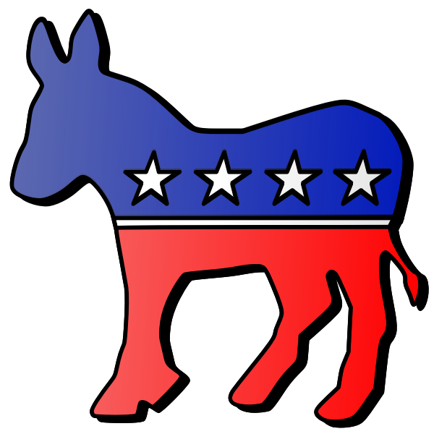
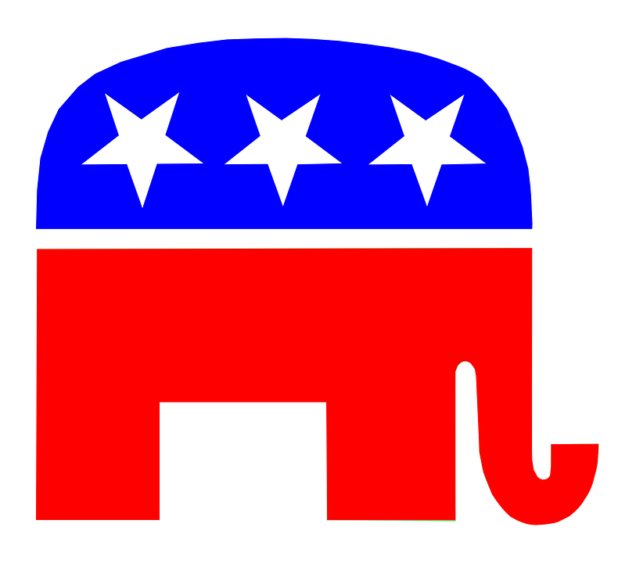
From triadic balance to structural balance
The fundamental theorem of structural balance was discovered by the mathematicians Dorwin Cartwright and Frank Harary in 1956
  It states that when a graph is balanced it can be split into two groups such that there are only positive links within groups and only negative links between groups
Balance is not necessarily good!
B
A
C
F
D
E

Slide 40
From triadic balance to structural balance
The fundamental theorem of structural balance was discovered by the mathematicians Dorwin Cartwright and Frank Harary in 1956
  It states that when a graph is balanced it can be split into two groups such that there are only positive links within groups and only negative links between groups
Structural balance is equivalent to perfect group polarization
B
A
C
F
D
E

Slide 41
Models of Network Diffusion

Slide 42
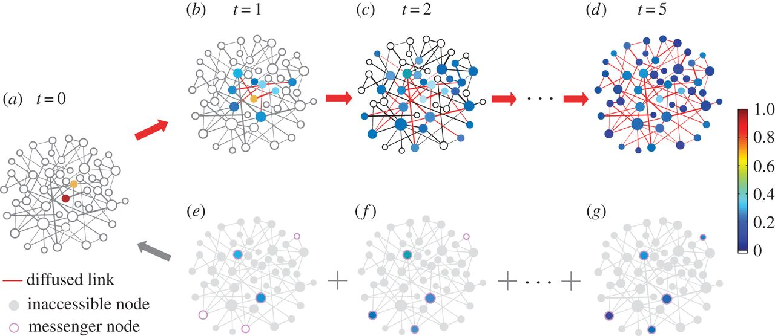
Social network models of diffusion
Four types of social network models of diffusion:
  Direct Cohesion Models
    Focus on the connectivity of adopters to their sources via network ties
  Two-Step Models
    Focus on the social distance between adopters and influential sources as well as characteristics of influentials
  Threshold Models
    Focus on susceptibility of adopters to the behavior of multiple sources
  Positional Equivalence Models
    Focus on indirect influence and comparison between sources and structurally similar adopters

Slide 43
Diffusion via Cohesion
Simplest model of diffusion
Innovations “travel” via social network links
  Focuses on how innovations spread within networks
  Focuses on how patterns of connectivity help (or hinder) diffusion
  Imitation or adoption via the similarity heuristic is the main mechanism
Adopter
Innovation
Source
Adopter
Adopter
Imitation
Imitation
Adopter

Slide 44
Diffusion via Cohesion
Simplest model of diffusion
Innovations “travel” via social network links
  Focuses on how innovations spread within networks
  Focuses on how patterns of connectivity help (or hinder) diffusion
  Imitation or adoption via the similarity heuristic is the main mechanism
Similarity heuristic:
  I adopt the innovations that people like me adopt (homophily)
  Imitation mechanism
Adopter
Innovation
Source
Adopter
Adopter
Imitation
Imitation
Adopter

Slide 45
Diffusion via Cohesion
Simplest model of diffusion
Innovations “travel” via social network links
  Focuses on how innovations spread within networks
  Focuses on how patterns of connectivity help (or hinder) diffusion
  Imitation or adoption via the similarity heuristic is the main mechanism
Innovations diffuse like a “virus” (sometimes literally)
  Contagion mechanism
    Sharing a meme on social media (“going viral”)
Adopter
Innovation
Source
Adopter
Adopter
Contagion
Contagion
Adopter

Slide 46
Two step models of diffusion
Basic claim:
  Innovations diffuse via opinion leaders (“influencers”)
  Potential sources look up to opinion leaders to see what innovations they should adopt
Who are opinion leaders?
  “[P]eople who influence the opinions, attitudes, beliefs, motivations, and behaviors of others” (Valente and Pumpuang 2007: 881)
Opinion leaders are “early” or first adopters
  This is why this is called “two-step” diffusion
Innovation
Innovation
Original
Source
Opinion
Leader
Adopter
Access
Influence

Slide 47
Two step models of diffusion
Characteristics of opinion leaders:
  People who are visible (e.g., celebrities, instagram influencers)
  People who occupy powerful positions (e.g., politicians, captains of industry)
  People who are well connected
    Degree centrality (Popular people)
    Eigenvector centrality (People who can influence popular people)
    Betweenness centrality (People who can intermediate between groups)
Innovation
Innovation
Original
Source
Opinion
Leader
Adopter
Access
Influence

Slide 48
Two step models of diffusion
We can combine the two-step and cohesion models
  Innovations begin at a source and are transferred to opinion leaders
  Opinion leaders then transfer the information to adopters
  Innovation spreads via cohesion among adopters in the second step
1
2
3
Adopter
Innovation
Innovation
Original
Source
Opinion
Leader
Adopter
Adopter
Access
Influence
Imitation
Adopter

Slide 49
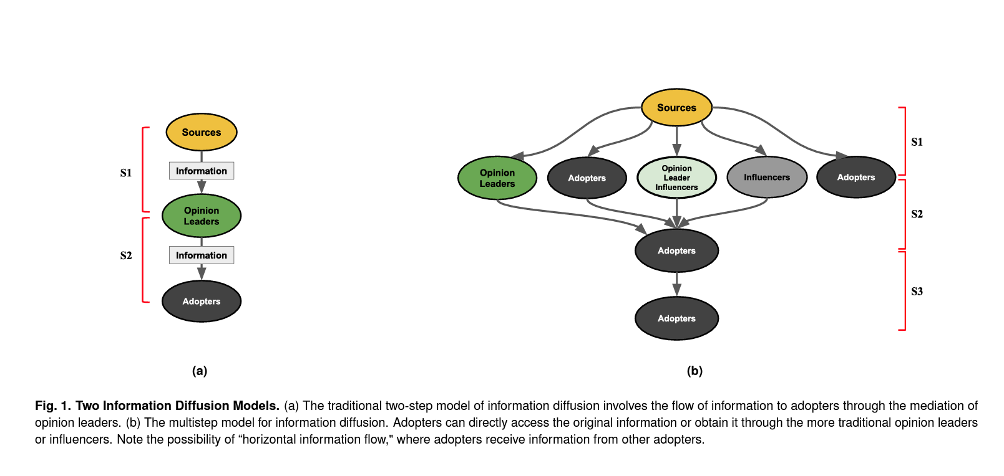

Slide 50
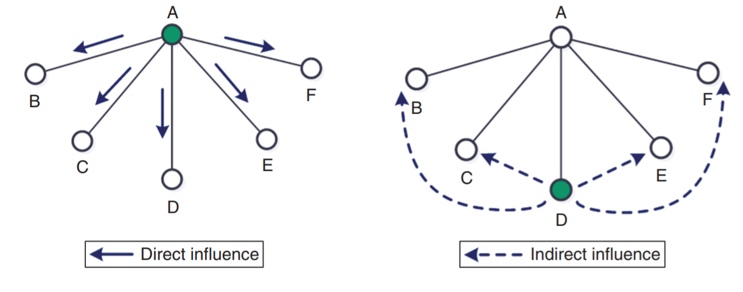
Positional equivalence model
Cohesion-based network models presume that diffusion only happens between connected actors (direct influence)
  However, the diffusion mechanism can sometimes operate among disconnected actors
This is diffusion via positional equivalence (indirect influence)
  Flashback: Positionally equivalent actors don’t have to be necessarily connected to one another!

Slide 51
Positional equivalence model
Cohesion-based network models presume that diffusion only happens between connected actors (direct influence)
  However, the diffusion mechanism can sometimes operate among disconnected actors
This is diffusion via positional equivalence (indirect influence)
  Mechanism: Comparison to similarly positioned others
Innovation
Source
Adopter
Comparison
Alter
Alter
Alter
Alter
Alter
Alter

Slide 52
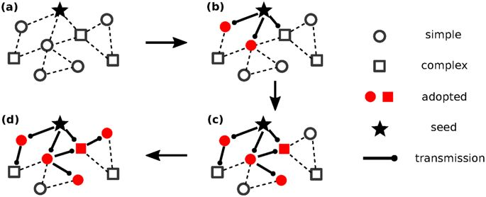
Complex versus simplex contagion
Innovations that entail risk, ostracism, potential loss of resources, may elicit higher thresholds from all actors in the network
  Persons require exposure to multiple sources to adopt
This is the difference between simplex and complex contagion
  Certain innovations only diffuse via complex contagion

Slide 53
Complex versus simplex contagion
Candidates for simplex contagion:
  Information, gossip, disease
Candidates for complex contagion:
  High risk social movement participation, religious conversion, migration, etc.

Slide 54
Complex versus simplex contagion
Weakness of long ties argument (Centola and Macy 2007):
  Long (weak) ties help to spread things in networks faster
    But only for things that spread via simplex contagion
  They are worse at spreading things that require complex contagion
    You are usually connected to one network bridge and access the tie infrequently

Slide 55
Complex versus simplex contagion
Information, gossip, disease:
  Can spread faster in a network via weak ties (bridges)
    Strength of Weak Ties (Granovetter 1973)
High-risk social movement participation, religious conversion, migration:
  Can spread faster via cliques and strong ties

Slide 56
The social psychology of social networks

Slide 57
Cognition and social networks
Cognitive aspects of networks central to classical approaches such as balance theory
More recent work has rediscovered the cognitive psychological dimension of social networks
Main contemporary cognitive-psychological approaches:
  Freeman’s theory of schema-based network recall
  Krackhardt’s theory of Cognitive Social Structures (CSS)
  Research linking Personality and Social Network Outcomes

Slide 58
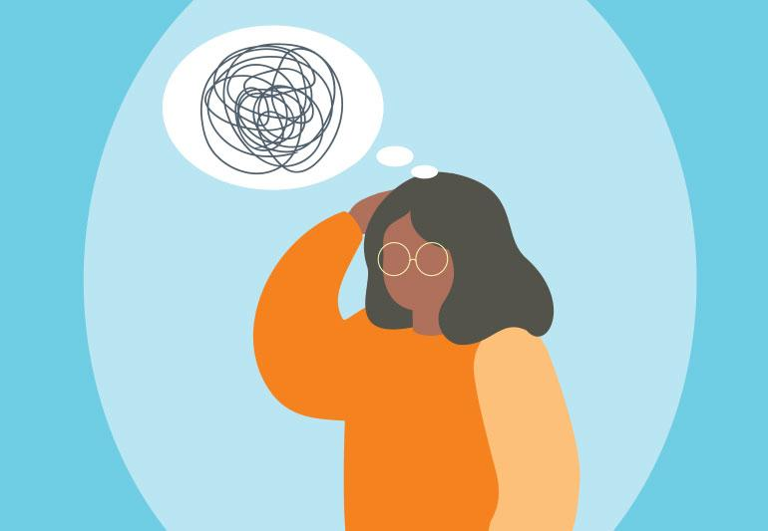
Remembering Social Structures
What kinds of networks are easy for people to remember?
  People store network information in a cognitive template called a schema

Slide 59
Remembering Social Structures
What kinds of networks are easy for people to remember?
  People store network information in a cognitive template called a schema
What are schemas?
  [C]ognitive structures consisting of a fuzzy set of interrelated associations that influence individuals’ perceptions of the world around them” (Brands 2013: S88)

Slide 60
Remembering Social Structures
What kinds of networks are easy for people to remember?
  People store network information in a cognitive template called a schema
Schemas influence memory
  We remember information consistent with stored schemas
  We forget information inconsistent with stored schemas
  We change schema inconsistent information into schema consistent forms

Slide 61
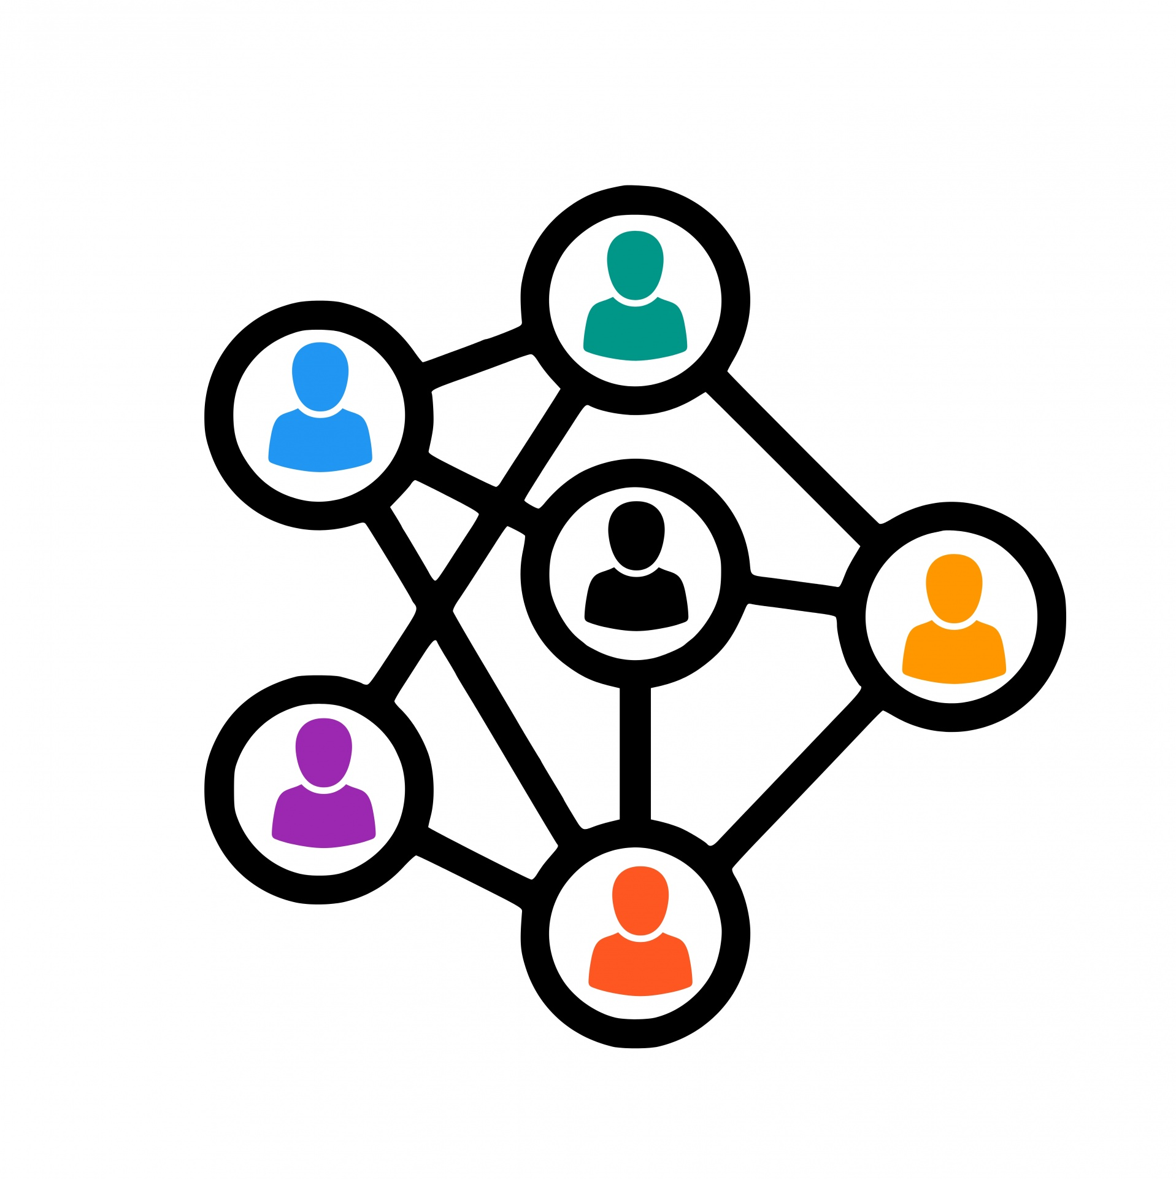
Remembering Social Structures
What kinds of networks are easy to remember?
  Networks with hierarchical structure are easier to remember
  Networks with reciprocity (if the relationship is friendship) are easier to remember
  Networks with transitivity are easier to remember
  Networks clustered into subgroups are easier to remember
  Networks featuring balance are easier to remember

Slide 62
Schema-based network recall
The balance schema:
  Friends of friends are friends
  Friends of enemies are enemies
People find it easier to remember social structures respecting the balance schema
  People recall signed networks as obeying the balance schema even if the original network violates the rules
  They impose “balance” to valenced social structures in their heads

Slide 63
Schema-based network recall
The transitivity schema:
  If a has a tie with b and a has a tie with c, b should have a tie with c
People find it easier to remember social structures respecting the transitivity shema
  Especially if these are hierarchical or dominance structures
  People recall networks as obeying the transitivity schema even if the original network violates the rules
    (e.g., has a lot of “open” triads)

Slide 64
Schema-based network recall
The reciprocity schema:
  If a likes b then b should like a
People find it easier to remember social structures respecting the reciprocity shema
  Especially if the network is a friendship or positive sentiments network
  The schema for friendship and liking is “reciprocal”
  People recall networks as obeying the reciprocity schema even if the original network violates the rules
    (e.g., has a lot of non-reciprocal dyads)

Slide 65
Cognitive Social Structures
What are cognitive social structures?
  It is the network of connections between people (including yourself but also between others) as each person perceives it to be rather than as it “really” is
  We go from asking:
    Is person i connected to person j?
  To asking:
    Does person k think that person i is connected to person j?
  This means that in a network of size N:
    Each relationship in the network exists N times as recorded inside the head of each the people in the network!
  We go from a dyadic conception of relations (R_{ij}) to a triadic one:
    R_{ijk} (person is connected to person j according to person k)

Slide 66
Cognitive Social Structures (CSS)
CSS provides new ways of measuring social ties between two people
  Makes the standard approach (e.g., mutual nomination) a special case
CSS modifies standard theories of networks as social capital
  Adds a perceptual component:
    Connections can help but only if you see them!
CSS focuses on three main questions:
  Is there a link between people’s network position (e.g., centrality) and the way the perceive the network?
  Is there a link between how people perceive the network they are in and how successful they are?
  Are there patterned similarities and differences between the way different people perceive the network?

Slide 67
Cognitive Social Structures (CSS)
The CSS Roster Method
  Each person (i) is asked not just about their relations to other persons (j)
  But also about their perception of the existence of relations between each other pair of people in the system:
    The tie between j and k as perceived by i
      R_{ijk} = 1 if person i thinks that there is a link of type R between j and k
      R_{ijk} = 0 otherwise
  This yields N x R adjacency matrices of perceived relations between all people
    One for each informant and each type of relation
  So if we are studying 20 people and ask them about two relations (e.g., friendship, advice) we end up with:
    20 X 2 = 40 adjacency matrices!

Slide 68
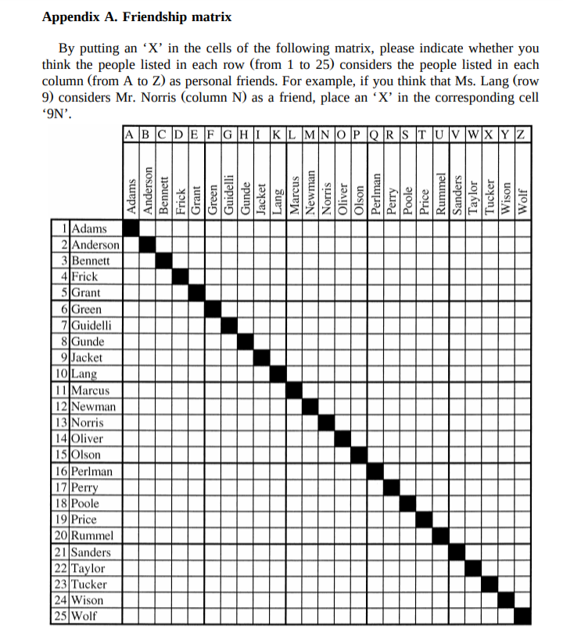
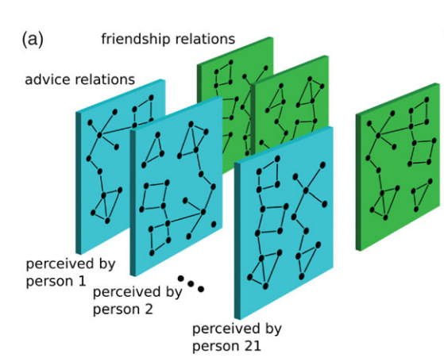
Cognitive Social Structures

Slide 69
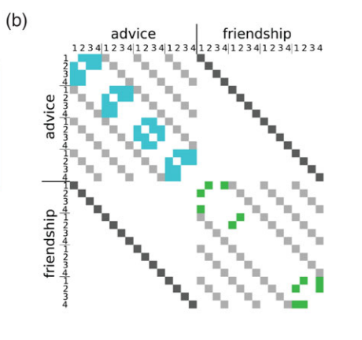
Cognitive Social Structures

Slide 70
Cognitive Social Structures (CSS)
Three ways of using the information contained in these matrices:
  Slices
  Locally aggregated structures
  Consensus structures
Slices
  The network as perceived by a given individual (k)
    The k^{th} adjacency matrix

Slide 71
Cognitive Social Structures (CSS)
Three ways of using the information contained in these matrices:
  Slices
  Locally aggregated structures
  Consensus structures
Locally Aggregated Structure:
  i and j have a tie only if the both agree that there is a tie from i to j
    A tie exists only if both parties agree it does!

Slide 72
Cognitive Social Structures (CSS)
Three ways of using the information contained in these matrices:
  Slices
  Locally aggregated structures
  Consensus structures
Consensus Structure:
  i and j have a tie only if some proportion of people (e.g., > 50%) agree that there is a tie from i to j
    A tie exists if the majority agrees it does!

Slide 73
Cognitive Social Structures (CSS)
Cognitive Accuracy:
  Correlation between the network as perceived by k and either a locally aggregated or a consensus structure
    +1 = Person has perfect representation of the network
    -1 = Person’s representation is the opposite of reality
    0 = No correlation between person perception and the network

Slide 74
Cognitive Social Structures (CSS)
Dyadic Cognitive Accuracy:
  Correlation between the network as perceived by k and the part of either a locally aggregated or a consensus structure featuring ties involving a particular node (i)
  Tells us how good you are at perceiving ties originating from a given person

Slide 75
Cognitive Social Structures
Who has the most “veridical” view of the social network?
  Key questions:
    Are people in powerful positions more or less likely to have accurate representations of the social structure?
    Are people in certain network positions (e.g., central) more likely to have accurate representations of the social structure?
      Does this depend on the type of network?
        E.g., friendship, advice, etc.
    Are people with certain personality characteristics more likely to have an accurate representation of the social structure?

Slide 76
Cognitive Social Structures
Are people in powerful positions more or less likely to have accurate representations of the social structure?
  Surprisingly, no!
    Organizational rank and formal position in organizations tends to have either no correlation or even be negatively correlated with accuracy
  Why do you think this is?
    Those in formal power are removed from the everyday informal interactions of others
    However, when managers do have accurate representations of the social networks of their subordinates they are rated as better and more effective

Slide 77
Cognitive Social Structures
Are people in certain network positions (e.g., central) more likely to have accurate representations of the social structure?
  In general, yes!
  Centrality, in particular in-degree centrality, has been shown to be positively correlated with accuracy in the informal advice and friendship networks in organizations
Predictors of dyadic accuracy:
  Central people are more accurate at reporting ties originating from other central people!
  You are more accurate in reporting ties originating from people you are “close to” (in the graph theoretic sense)

Slide 78
Cognitive Social Structures
Are people in certain network positions (e.g., central) more likely to have accurate representations of the social structure?
  In general, yes!
  Centrality, in particular in-degree centrality, has been shown to be positively correlated with accuracy in the informal advice and friendship networks in organizations
Consequences of accuracy:
  The accuracy principle:
    People who have more accurate network perceptions are perceived as more powerful and influential than people who have inaccurate perceptions

Slide 79
Cognitive Social Structures
Who has the most “veridical” view of the social network?
  Sources of accuracy:
    The centrality principle:
      More central people have a more accurate view of the social structure in terms of reporting “correctly” who is tied to whom
        Correct = agrees with the respective alters
    The clique principle:
      People who are members of well connected cliques are more likely to have accurate perceptions of the social network than isolated or peripheral people
    The role principle:
      People with similar positions in the social network (e.g., structurally equivalent) will have similar perceptions of the overall network structure

Slide 80
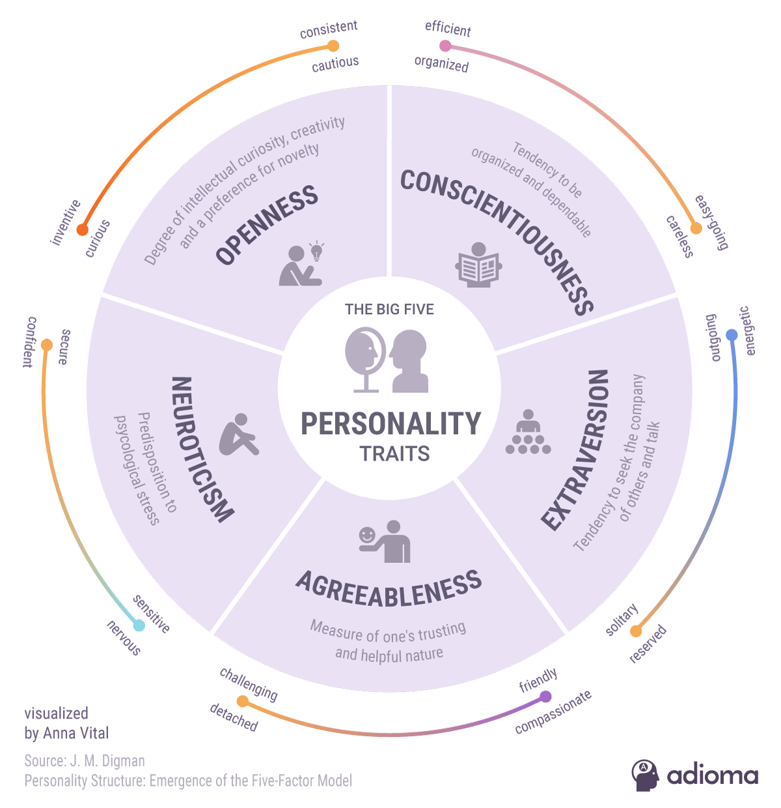
Personality traits and social networks
Big five (aka five factor model)
  Most well-established personality inventory
    Extraversion/Introversion
      Gets a high from interaction
    Openness/Cautiousness
      Like experiencing new things
    Neuroticism/Stability
      Experiences negative emotions
    Agreeableness/Detachment
      Niceness, resolves conflicts
    Conscientiousness/Carefreeness
      Organization, reliability

Slide 81
Personality traits and social networks
Neither end is necessarily “good” or “bad”
Big five (aka five factor model)
  Most well-established personality inventory
    Extraversion/Introversion
      Gets a high from interaction
    Openness/Cautiousness
      Likes experiencing new things
    Neuroticism/Stability
      Experiences negative emotions
    Agreeableness/Detachment
      Niceness, resolves conflicts
    Conscientiousness/Carefreeness
      Organization, reliability
Factors are bipolar (both ends are actual traits) not unidimensional!

Slide 82
Personality traits and social networks
Neither end is necessarily “good” or “bad”
Big five (aka five factor model)
  Most well-established personality inventory
    Extraversion/Introversion
      Prefers self-reflection
    Openness/Cautiousness
      Likes consistency and predictability
    Neuroticism/Stability
      Is more emotionally “balanced”
    Agreeableness/Detachment
      Distant/Emotionally neutral
    Conscientiousness/Carefreeness
      Spontaneous/disorganized
Factors are bipolar (both ends are actual traits) not unidimensional!

Slide 83
Personality traits and social networks
People high in trait extraversion:
  Have larger networks at all layers
  Tend to be part of strong tie triads
  More likely to introduce friends of friends
  Add new contacts at a faster rate
  Have higher indegree and outdegree centrality
People high in trait neuroticism:
  Have smaller ego-networks
  Tend to be part of weak tie triads
  Are less like to introduce friends of friends
Active Network(120-150)
Affinity Group (45-50
Ego
Sympathy Group (12-15)
Support Clique (4-5)
Ego
Tie Strength

Slide 84
Personality traits and social networks
People high in trait extraversion:
  Have larger networks at all layers
  Tend to be part of strong tie triads
  More likely to introduce friends of friends
  Add new contacts at a faster rate
  Have higher indegree and outdegree centrality
People high in trait agreeableness:
  Have higher indegree
  Add new contacts at a faster rate
Active Network(120-150)
Affinity Group (45-50
Ego
Sympathy Group (12-15)
Support Clique (4-5)
Ego
Tie Strength

Slide 85

Personality traits and social networks
Self monitoring:
  Are you a “social chameleon” who changes depending on who you are interacting with and the social context or are you the same person regardless?
  “[I]ndividuals high in self-monitoring...regulate their expressive self-presentation for the sake of desired public appearance…[they are] highly responsive to cues of social and interpersonally-appropriate performances
    (Snyder and Gangestad, 1986, p. 128)

Slide 86
Personality traits and social networks
Self monitoring:
  Are you a “social chameleon” who changes depending on who you are interacting with and the social context or are you the same person regardless?
  Individuals low in self-monitoring...lack...the motivation to...reflect [on] their own enduring and momentary inner states, including their attitudes, traits and beliefs”
    (Snyder and Gangestad, 1986, p. 128)

Slide 87
Personality traits and social networks
Self monitoring:
  Are you a “social chameleon” who changes depending on who you are interacting with and the social context or are you the same person regardless?
Self-monitoring is a type of social skill:
  Use of humor in interaction
  Appropriate pace in conversation
  Less likely to do “self-talk”
  More likely to do “other talk”
  Likely to collaborate and compromise

Slide 88
Personality traits and social networks
Self monitoring:
  Are you a “social chameleon” who changes depending on who you are interacting with and the social context or are you the same person regardless?
Self-monitors:
  Have higher indegree
    In both sentiment (e.g., friendship) and exchange (e.g., advice) networks
  More likely to bridge structural holes
    Betweenness centrality
    But only in sentiment networks

Slide 89
The End!

